Slide 1
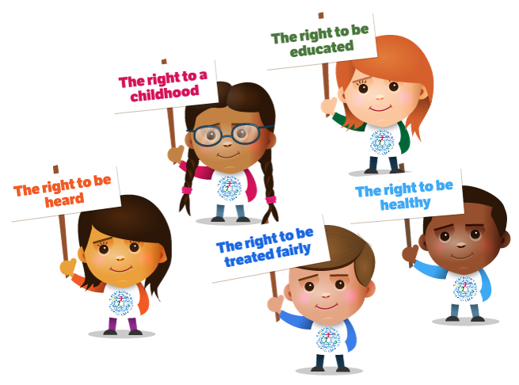
Safeguarding Policy for children
Policy reviewed: October 2021
Next review: October 2022

Slide 2
What is this policy for?
What is safeguarding?
It is everyone at school looking after your health, safety and well being, inside and outside of school.
To help you decide what could be a problem and where to get help and support. It is really important that you know who you can talk to and also to understand why you might need to talk to someone.

Slide 3
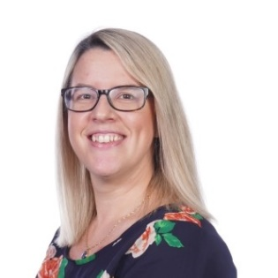
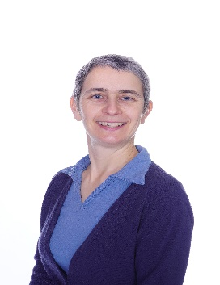
The Designated Safeguarding Leads are:
Who can you talk to?
If you are worried about something you can talk to any adult in school. This could be any adult you trust at school, including any of the Designated Safeguarding Leads.
Mrs Kersh
Mrs Peters
Mrs Seymour Smith
Mrs Nikolaides
What is a Designated Safeguarding Lead?
In every school there is always somebody who has the responsibility to keep you safe and all staff have to tell that person if they are worried about you. Staff have training and are taught how to keep children safe as it is the most important part of their job.

Slide 4
What should you do?
Tell someone if someone, including a family member is:
Bullying you
Saying things to you that upset you or make you feel uncomfortable
Touching you in anyway that makes you uncomfortable
Hitting you or hurting you
Taking your things
Sending unkind messages on the internet or to your phone
Making you watch things that make you uncomfortable
Not feeding you, clothing you properly or keeping you warm
Most importantly you do NOT have to keep your worries a secret!

Slide 5
What will adults do?
All adults will listen to what you have to say with an open mind.
Adults will not ask leading questions so that you have to reveal more details.
If they are worried about your safety, they might invite another professional to talk to you.
Adults never stop us from freely talking or sharing about significant events
Adults will make accurate and specific notes of discussions to make sure that all concerns are recorded.
Adults will not promise to keep secrets. They will explain that they have a responsibility to report what has been said to someone else if they are worried about your safety.
All adults will immediately tell the Safeguarding team if they are worried about your safety.

Slide 6
The Designated Safeguarding Leads are:
Is something worrying you?
If you are worried about something you can talk to any adult in school. This could be any adult you trust at school, including any of the Designated Safeguarding Leads.
Mrs Kersh
Mrs Peters
Mrs Seymour Smith
Mrs Nikolaides
What is a Designated Safeguarding Lead?
In every school there is always somebody who has the responsibility to keep you safe and all staff have to tell that person if they are worried about you. Staff have training and are taught how to keep children safe as it is the most important part of their job.

