Slide 1
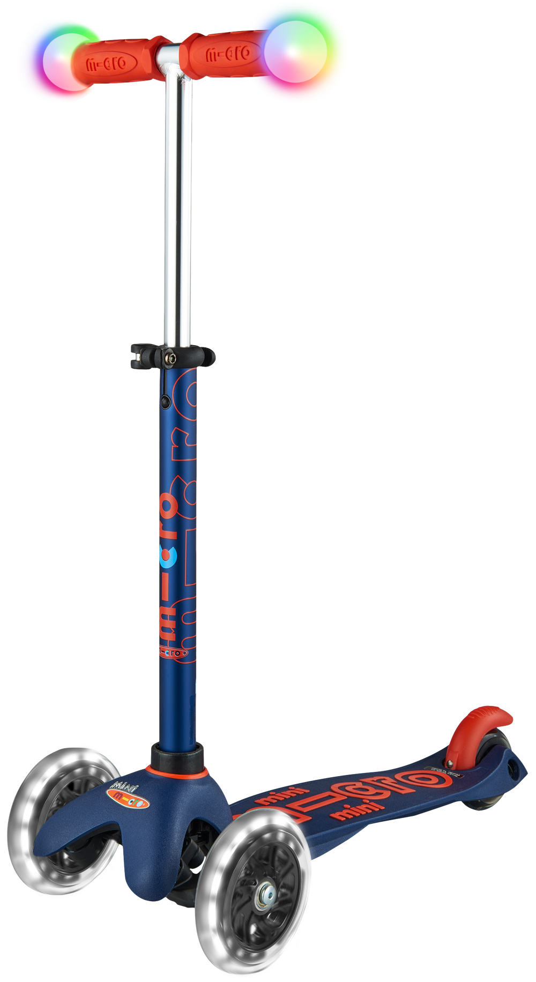
25% Off Mini Deluxe Magic
Special Offer
DETAILS
When purchasing in multiples of 4. 4 being the minimum
Available to schools until 31st December 2023
Whilst stocks last
RRP £87.95

Slide 2
25% Off Mini Deluxe Magic
Special Offer
FEATURES
Light up adjustable handlebar
Induction powered light up wheels
For ages 2-5
RRP £87.95
Was £50.10 Now £37.60 net

Slide 3
The magic mile
We believe scooting at least 1 mile every day should be the component to your 5-a-day
20% of UK journeys are under a mile – That’s just a 6 minute scoot
For every mile travelled by scooter instead of car, CO2 emissions will be reduced by 400g

Slide 4
Why buy a Micro Scooter?

Slide 5
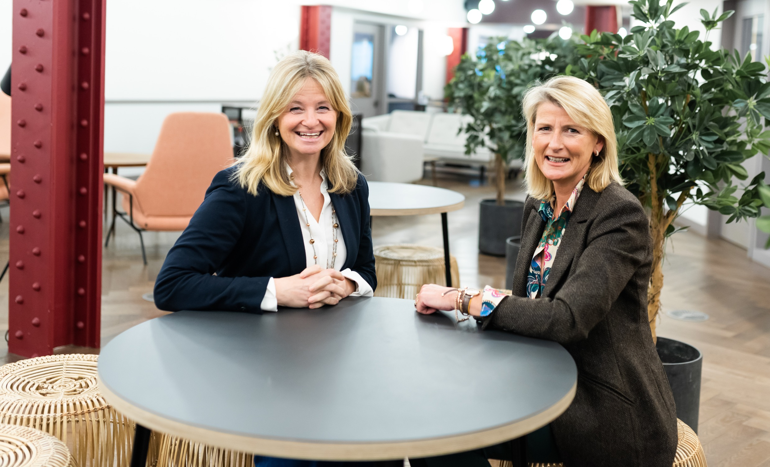
Why make it a Micro?
We’re on a mission to make everyday journeys better. Better for today’s families. Better for our world.
We think riders of all ages should be able to move their own way. And we think moving without limit starts by thinking without limit. Asking questions. Imagining possibilities.
Transforming the everyday. It’s where our Micro journey began. It’s what drives us forward. It’s the reason we will never stand still.
People powered. Planet friendly. In it for the long haul.
Micro Scooters. Made for adventure. Built to last.
Meet the mums behind the brand
Started in 2004 by Anna Gibson and Phillipa Gogarty.
Fast forward 20 years and the friends have been responsible for getting over 1 million children scooting to school everyday.
Now more and more adults are getting in on the act using adult scooters themselves for everything from the journey to work, weekend adventures to even the pop to the shop for that forgotten pint of milk.

